Slide 1
Outrageously fast interactive heatmap graphics using R, JavaScript, and Plotly
Bohdan Khomtchouk, Ph.D.
Department of Biology
Stanford University

Slide 2
Background
Heatmaps convert high dimensional numerical data into a colored grid of cells
Numbers → colors
“Curse of dimensionality”
The proverbial “blue screen of death” … heatmap-style
Readability issues

Slide 3
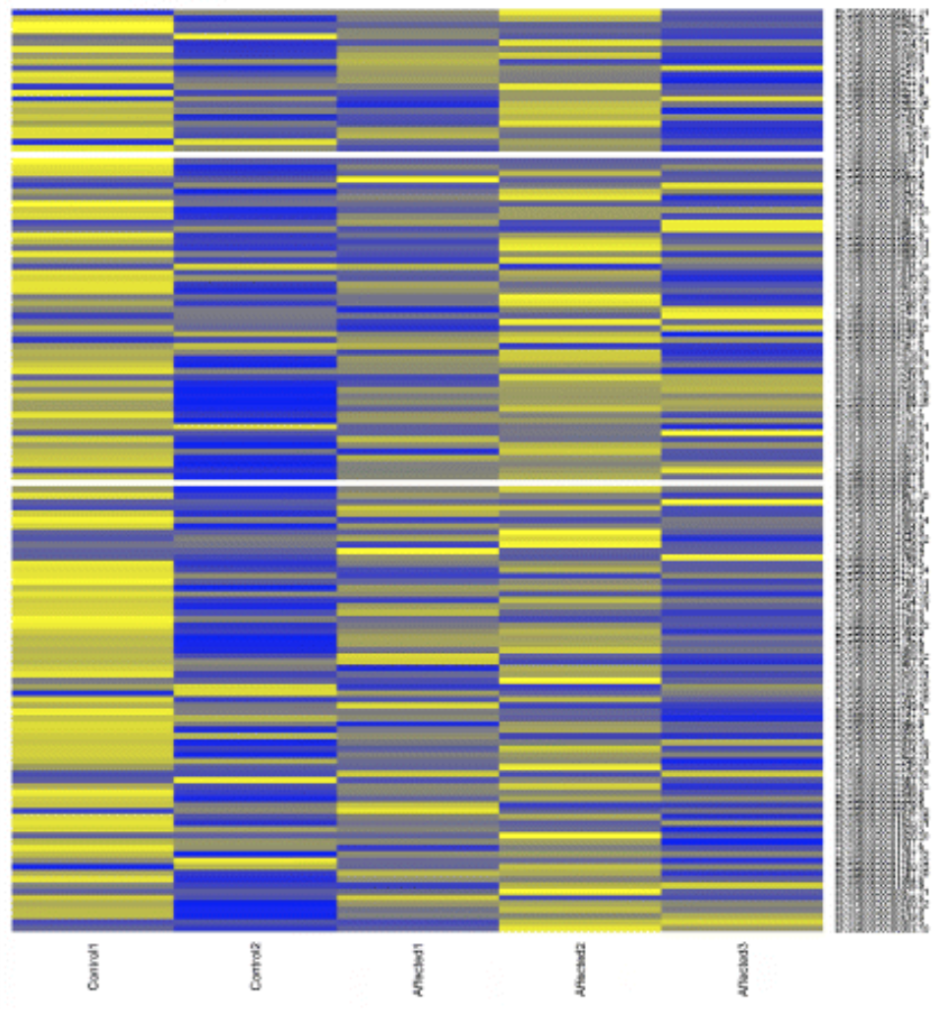
Can you read that?

Slide 4
Background
Static vs. interactive heatmaps
For computational cost (as you might expect):
interactive >> static
In general, interactive heatmaps are EXPENSIVE

Slide 5
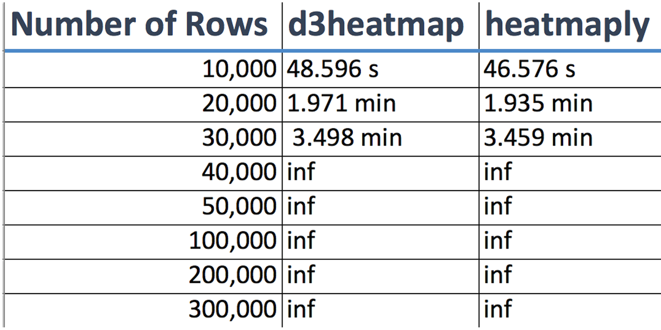
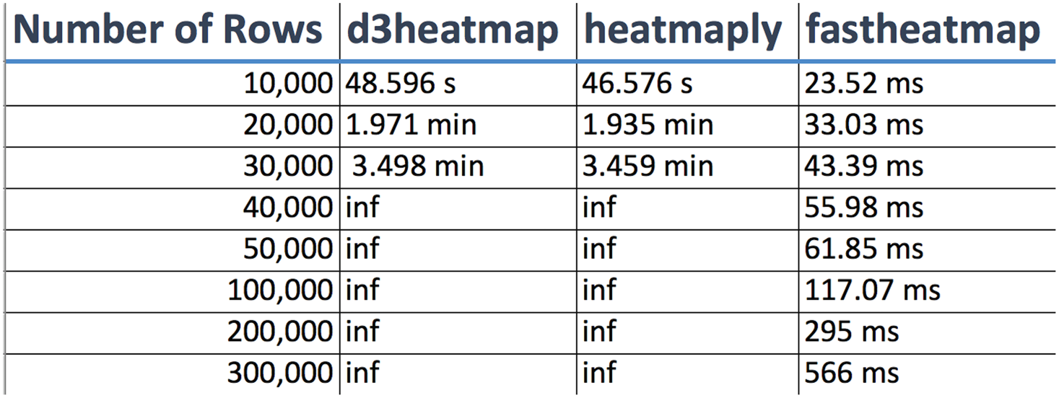
Some benchmarks
Number of columns: 8
“Inf” = infinity (system crash)
Notes:
All benchmarks were tested on a 64-bit Windows 10 Pro desktop machine with 16.0 GB of RAM and an Intel(R) Core(TM) i7-5820K CPU at 3.30 GHz.

Slide 6
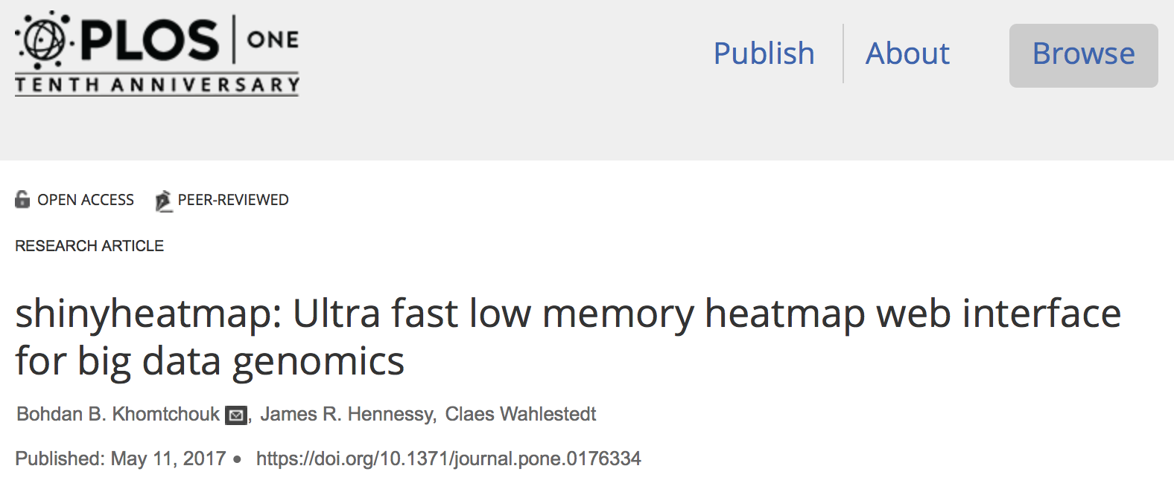

Slide 7
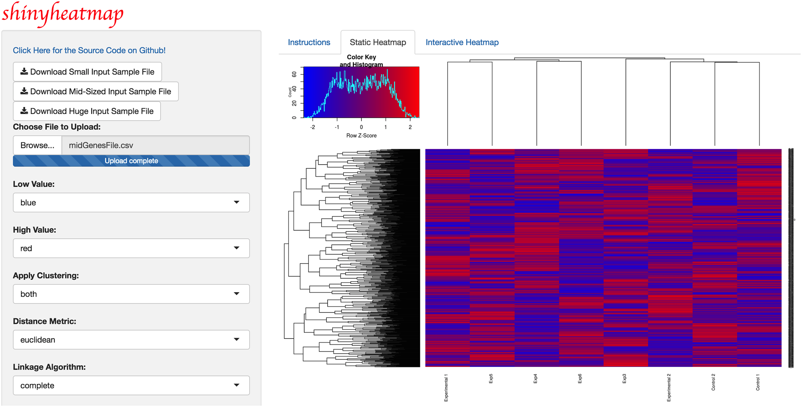
http://shinyheatmap.com/

Slide 8
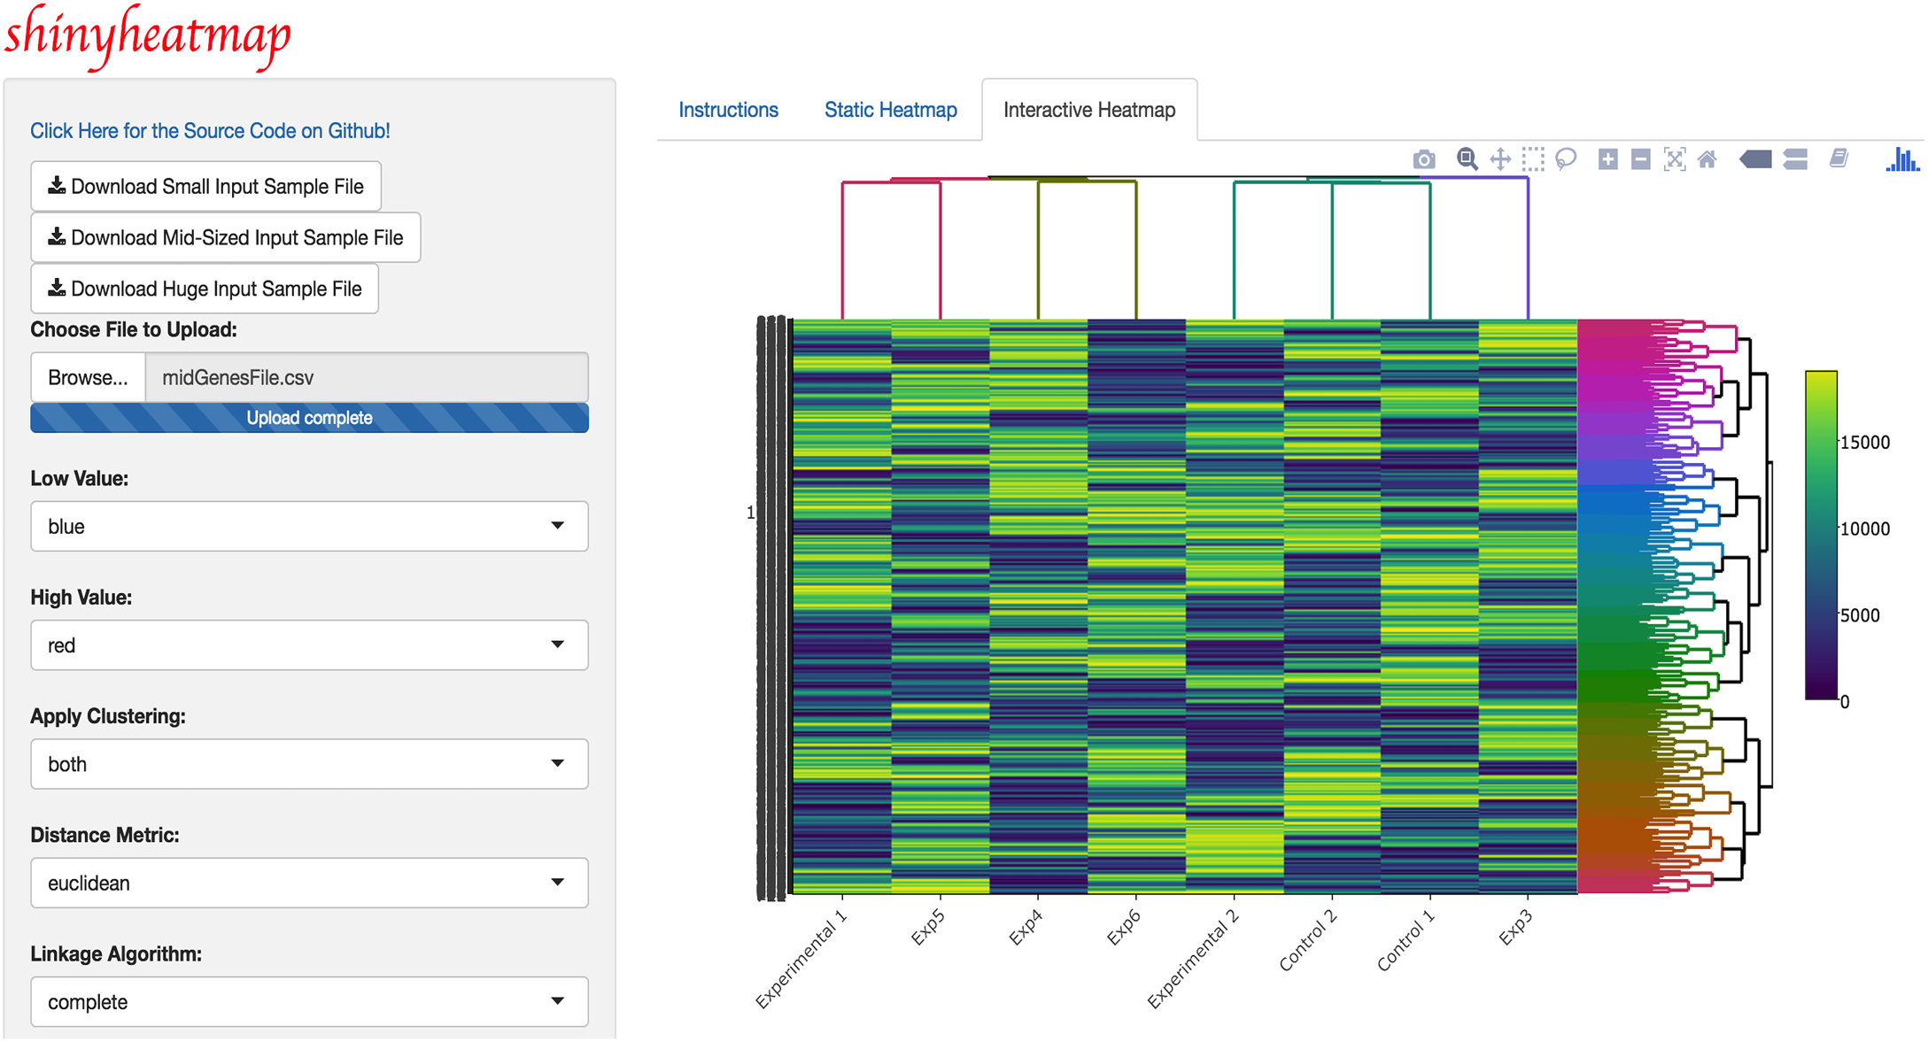
http://shinyheatmap.com/

Slide 9
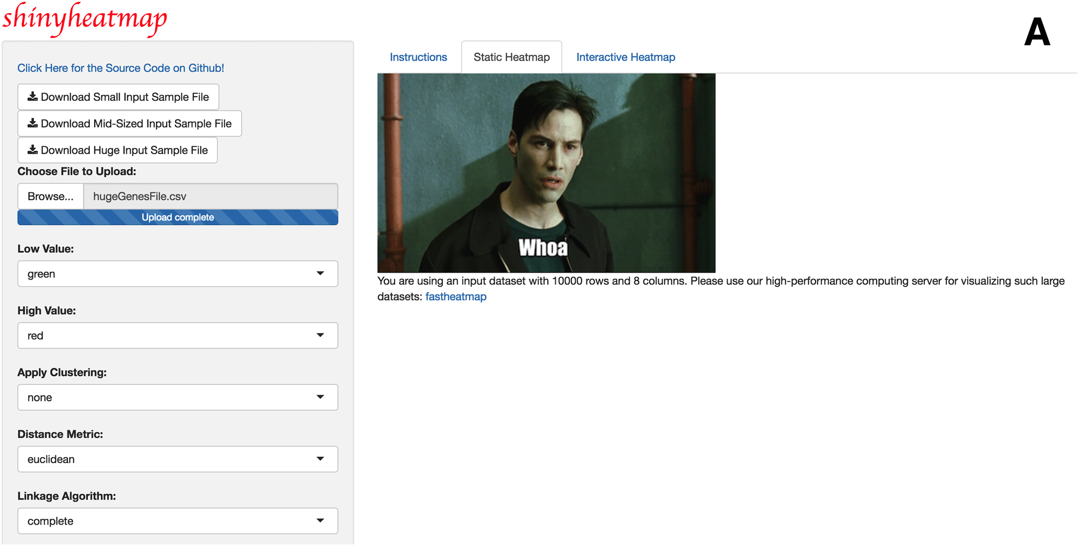
If your heatmap is too big…

Slide 10
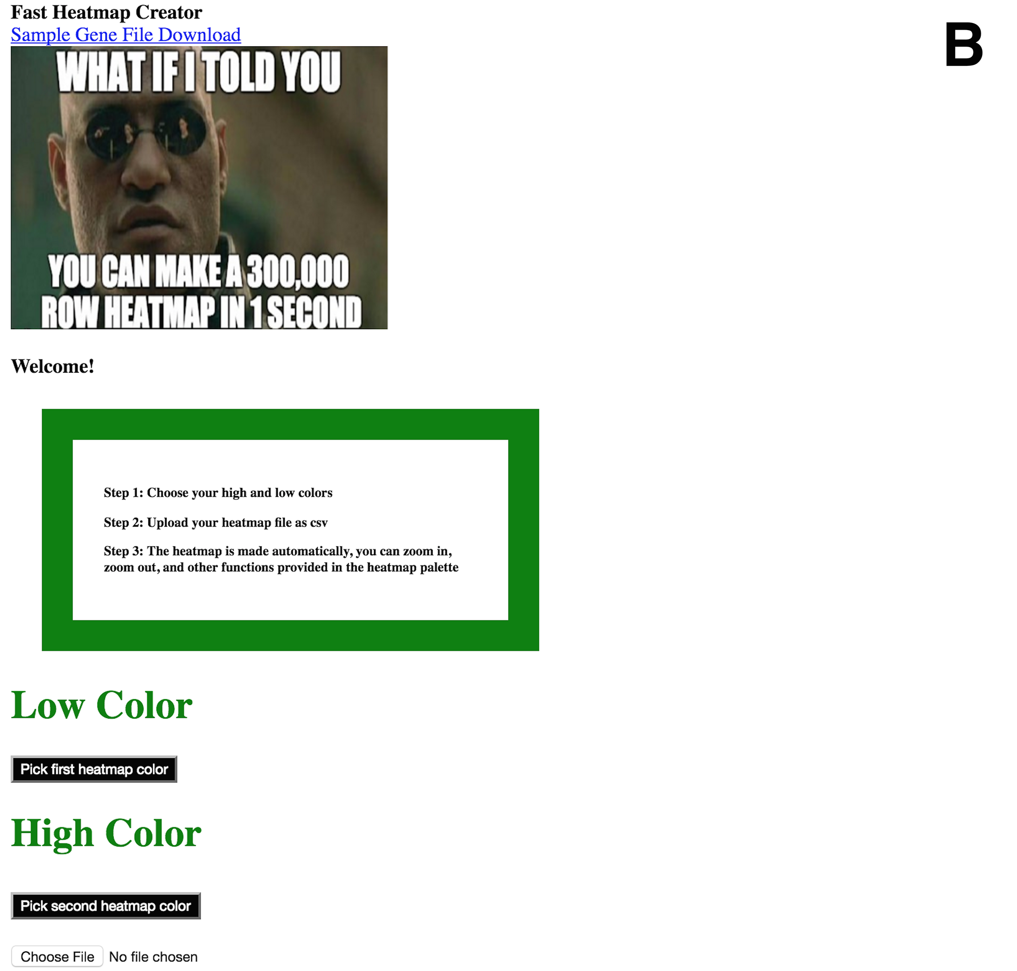
http://fastheatmap.com/

Slide 11
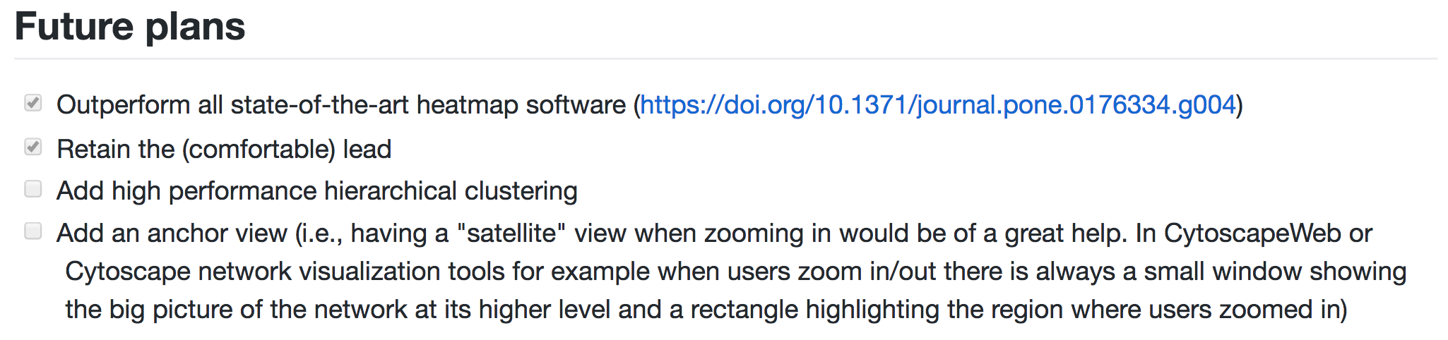
Future directions

Slide 12

Star it!

Slide 13
Q/A

